Slide 1
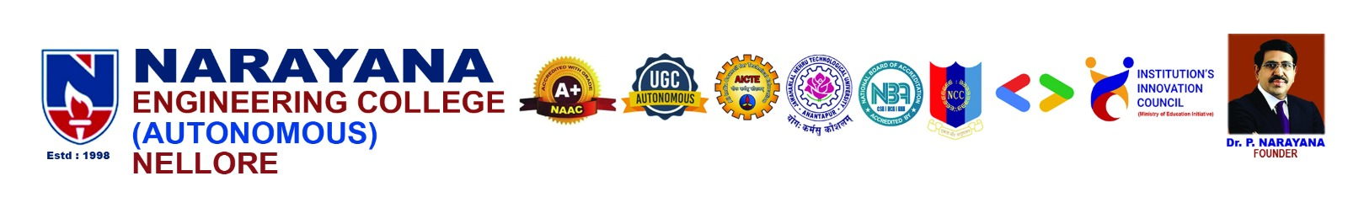

DEPARTMENT OF
ELECTRONICS AND COMMUNICATION ENGINEERING
IoT-Based Predictive
NARAYANA ENGINEERING COLLEGE (AUTONOMOUS), NELLORE
Irrigation Scheduling
Dept. of Electronics & Communication Engineering
Using VPD & Solar Flux Fusion
Team Members
P.Hari Chandana
S.Sri Lakshmi
Md.Eram Zulekha
Sk.Afreen
-
-
-
-
22711A0446
22711A0454
22711A0435
23715A0404
Guide: Mr. V. Praveen Kumar, M.Tech., (Ph.D)
Assistant Professor, Dept. of ECE

Slide 2
CONTENTS
ABSTRACT
INTRODUCTION AND PROBLEM STATEMENT
OBJECTIVE
SYSTEM WORKING
HARDWARE COMPONENTS
PROJECT SETUP AND WEB DASHBOARD
VPD CONCEPT
IOT DASHBOARD
RESULT AND ANALYSIS
ADVANTAGES AND DISADVANTAGES
APPLICATIONS
FURTURE SCOPE AND CONCLUSION
REFERENCES
Smart Irrigation — Smarter Farming — Sustainable Future | Narayana Engineering College, Nellore

Slide 3
ABSTRACT
This project presents a smart irrigation system that moves beyond traditional soil moisture–based methods by using the Atmosphere-Plant-Soil (APS) model. It integrates sensors like BME280 and BH1750 with an ESP32-S3 to calculate Vapor Pressure Deficit (VPD), reflecting real-time atmospheric demand. By combining soil moisture, solar intensity, and VPD trends, the system predicts future water needs instead of reacting late. An RTC-based scheduling system ensures irrigation at optimal times, reducing water loss. It also includes an IoT dashboard for monitoring and a fail-safe mechanism for system protection. Overall, the solution improves water efficiency and supports precision agriculture.
Keywords: VPD (Vapor Pressure Deficit) , Precision Agriculture, IoT, ESP32-S3, Solar Flux
Fusion, Predictive Irrigation
Smart Irrigation — Smarter Farming — Sustainable Future | Narayana Engineering College, Nellore

Slide 4
INTRODUCTION & PROBLEM STATEMENT
Introduction
Problems with Old Systems
Uses IoT sensors to monitor temperature, humidity, and sunlight.
VPD helps understand how much water plants need.
Solar flux shows how much sunlight plants receive.
Combines both data for better irrigation decisions.
Automatically controls watering to save water and improve crop growth.
Water only when soil gets dry — by then the plant is already stressed
1
No idea about how hot and dry the air is — VPD is never checked
2
Irrigating at noon loses water to evaporation instantly
3
Pumps run dry or pipes burst with no automatic protection
4

Slide 5
Objective
What is the Problem?
Farmers today waste a lot of water because they irrigate on a fixed schedule, without checking if the plants actually need water at that time.
What did we Build?
An IoT-based smart irrigation system that reads weather conditions and sunlight levels in real time, and decides when and how much to water — automatically.
What is the Result?
Our system saves up to 33% water compared to traditional methods, protects the pump from damage, and can be monitored from a phone or computer.

Slide 6
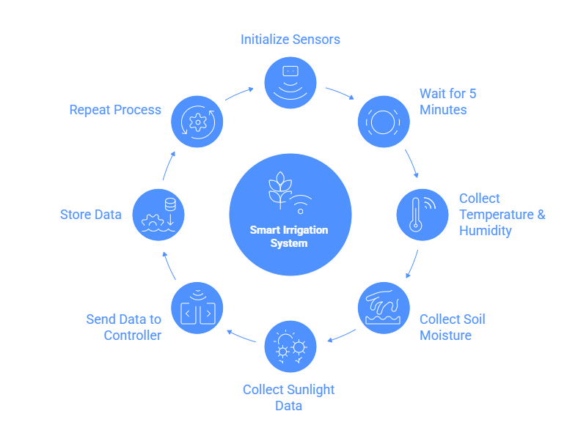
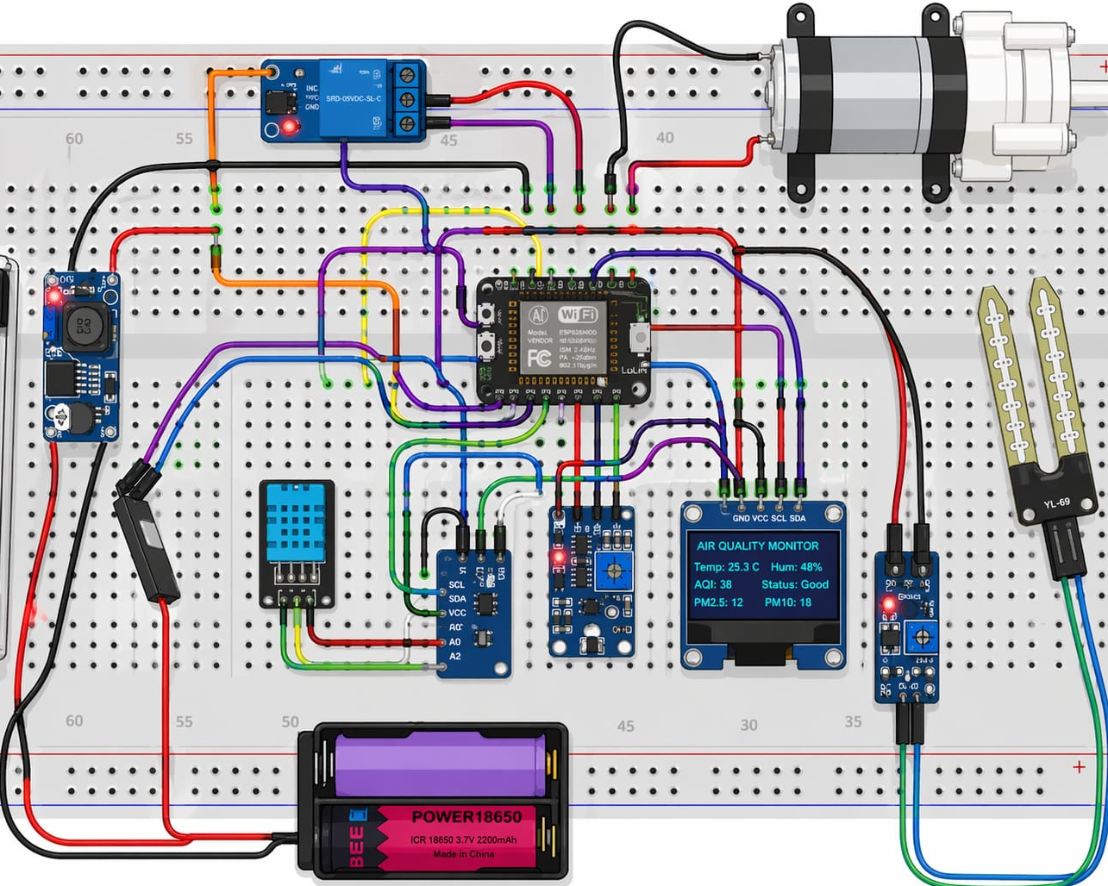
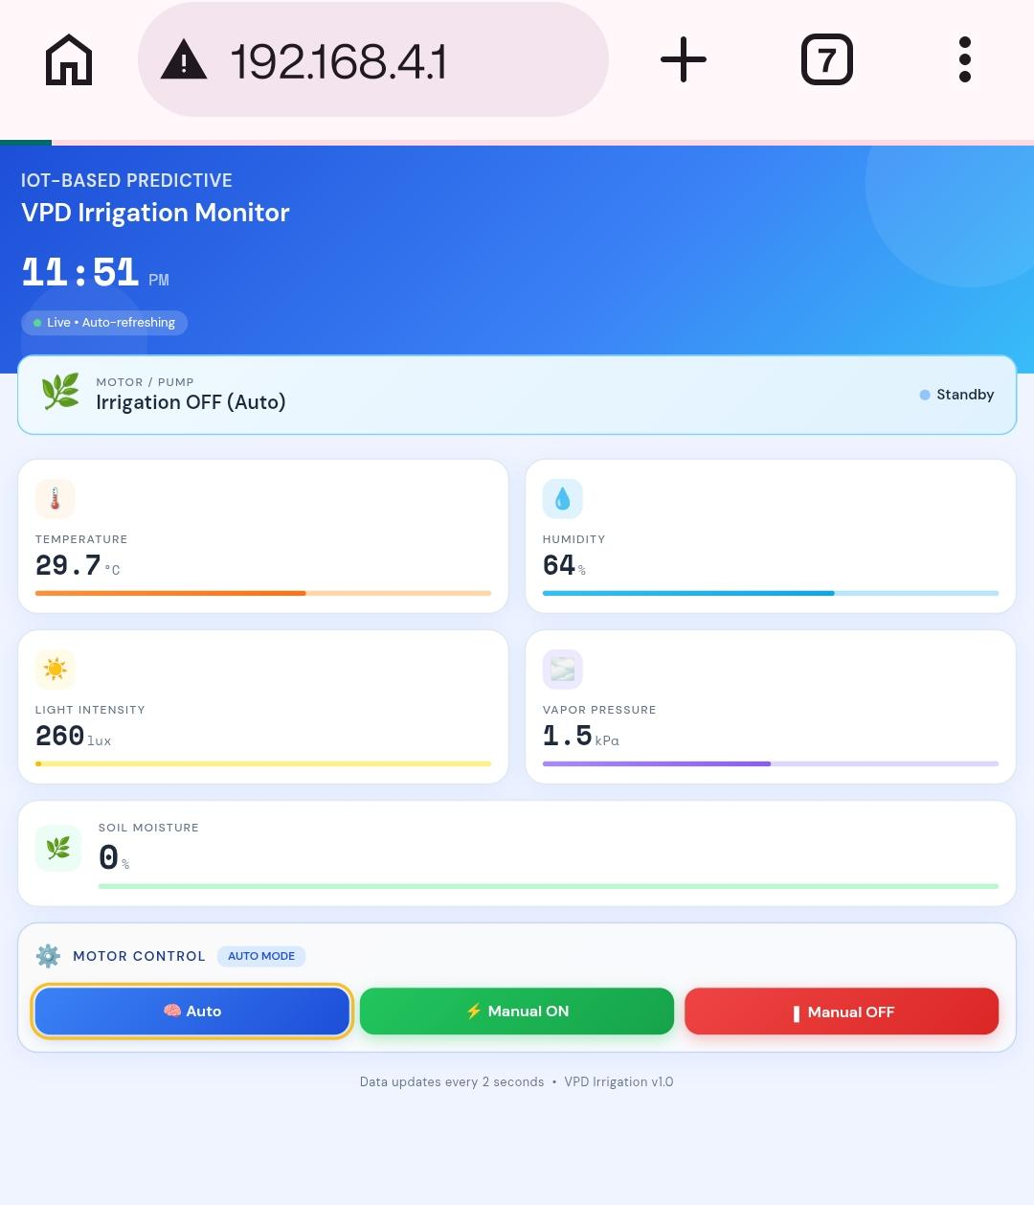
HOW THE SYSTEM WORKS
STEP 1
STEP 2
STEP 3
Sense
Think
Act & Report
The ESP32-S3 microcontroller processes the data, calculates plant water need, and decides when to irrigate
The pump is turned on/off automatically. Data is sent to a cloud dashboard viewable on phone or browser
Sensors collect temperature, humidity, sunlight, and soil moisture data every 5 minutes from the farm

Slide 7
HARDWARE COMPONENTS USED
ESP32-S3
BME280
BH1750
Brain (Microcontroller)
Weather Sensor
Sunlight Sensor
Processes all data and controls the pump. Has built-in Wi-Fi to send data to cloud.
Measures temperature, humidity, and air pressure — needed to calculate plant stress.
Measures how much sunlight is hitting the field — more sun means plants need more water.
DS3231 RTC
DHT Sensor
Soil Moisture Sensor
Clock Module
DHT Sensor
Soil Moisture Sensor
Keeps accurate time so irrigation always happens at the right window — never at noon.
Monitors temperature and humidity for irrigation optimization and climate-based control
Measures soil moisture level for efficient water control and crop growth.

Slide 8
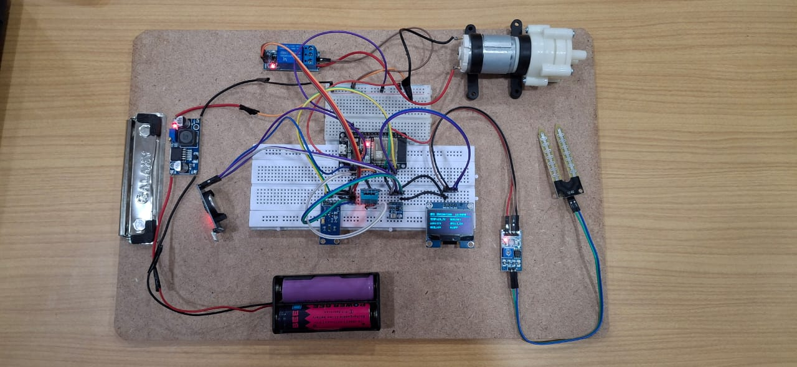
PROJECT SETUP AND WEB DASHBOARD
How it Works — Step by Step
Measure Sunlight , VPD, Humidity
Add It Up
1
The BH1750 sensor measures brightness (lux) every 2 minutes during the day
2
All lux readings are totalled throughout the day to get a Cumulative Solar Energy score
Combine with VPD
Predict & Act
3
The solar score and VPD are combined into one number — the Atmospheric Demand Index (ADI)
4
Using ADI, the system estimates when soil moisture will drop below safe levels and schedules watering.

Slide 9
WHAT IS VPD AND WHY DOES IT MATTER?
VPD stands for Vapour Pressure Deficit — it tells us how 'thirsty' the air is.
When the air is hot and dry, it pulls water out of plants very fast. This is HIGH VPD. When the air is cool and humid, plants lose water slowly. This is LOW VPD.
Very Low VPD
Medium VPD
High VPD
Very High VPD
Cool, humid air
Warm, partly humid
Hot, dry air
Very hot, very dry
Action:
Action:
Action:
Action:
Skip irrigation — plants are comfortable
Irrigate at the scheduled morning/evening time
Irrigate earlier and give a bit more water
Trigger emergency irrigation to protect crops

Slide 10
REMOTE MONITORING — IOT DASHBOARD
Farmers and managers can view all sensor data live on Adafruit IO — from any phone, tablet, or computer. Data is updated every 5 minutes automatically.
VPD Level
Soil Moisture %
Temperature & Humidity
Shows current plant stress level
Live reading of water content in the soil with a target range indicator
Current weather readings from the BME280 atmospheric sensor on the farm
Sunlight Level
24-Hour Trend Graph
Pump Control Switch
Real-time brightness reading showing how much solar energy is hitting the field
Chart showing how VPD and soil moisture changed through the day, with irrigation events marked
Manually turn the pump ON or OFF from your phone if needed — full override available

Slide 11
RESULTS — WHAT WE ACHIEVED
Water Used Per Day: Our System vs Traditional System
33%
Less water
used overall
50%
Savings on
overcast days
No stress
Soil stayed in
healthy range
99.2%
System uptime
over 15 days

Slide 12
ADVANTAGES AND DISADVANTAGES
Advantages
Saves water – Irrigation happens only when needed, so no wastage.
Better crop growth – Uses VPD and sunlight data to give plants the right amount of water.
Reduces manual work – System works automatically using IoT sensors.
Improves yield – Healthy watering leads to better production.
Smart decision-making – Combines multiple factors (humidity, temperature, sunlight) for accurate results.
Disadvantages
Depends on sensors and internet – If sensors give wrong data or the internet connection is weak, the system may not work properly.
Requires regular maintenance – Sensors need cleaning, calibration, and checking to keep the system accurate.
.
Smart Irrigation — Smarter Farming — Sustainable Future | Narayana Engineering College, Nellore

Slide 13
APPLICATIONS
Smart farming – Used in modern agriculture fields.
Greenhouses – Maintains ideal environment for plants.
Horticulture – Useful for fruits, vegetables, and flowers.
Urban gardening – Helps manage watering in small gardens or terraces.
Research farms – Used for studying plant growth and climate effects.
Smart Irrigation — Smarter Farming — Sustainable Future | Narayana Engineering College, Nellore

Slide 14
FUTURE SCOPE AND CONCLUSION
Future Scope
🌐 Expand to cover entire fields with multiple sensor nodes
🤖 Add AI/ML model to learn crop-specific water patterns
🌦️ Use weather forecast data to plan irrigation 1–2 days ahead
🌱 Build crop-specific settings for rice, cotton, vegetables, etc.
☀️ Add solar panels so the system runs without electricity
💰 Study cost savings vs investment to help farmers adopt it
CONCLUSION
The system dynamically adjusts irrigation schedules using real-time environmental data, ensuring optimal soil moisture while minimizing human effort. It prevents overwatering and underwatering by responding to changing weather conditions. Its low-cost and energy-efficient design makes it suitable for both small and large-scale farmers, especially in rural areas. The built-in fault detection and remote monitoring features improve reliability and reduce labor. Overall, it offers a scalable and sustainable solution for efficient smart farming.
Smart Irrigation — Smarter Farming — Sustainable Future | Narayana Engineering College, Nellore

Slide 15
REFERENCES
[1] N. Gondchawar and R. S. Kawitkar, "IoT Based Smart Agriculture," International Journal of Advanced Research in Computer and Communication Engineering, vol. 5, no. 6, pp. 838–842, June 2016.
[2] S. S. Patil and B. M. Kale, "A Model for Smart Agriculture Using IoT," in Proc. International Conference on Global Trends in Signal Processing, Information Computing and Communication (ICGTSPICC), Jalgaon, India, 2016, pp. 543–545.
[3] J. M. Gutiérrez, J. F. Villa-Medina, A. Nieto-Garibay, and M. Á. Porta-Gándara, "Automated Irrigation System Using a Wireless Sensor Network and GPRS Module," IEEE Transactions on Instrumentation and Measurement, vol. 63, no. 1, pp. 166–176, Jan. 2014.
[4] A. Sharma, A. Jain, P. Gupta, and V. Chowdary, "Machine Learning Applications for Precision Agriculture: A Comprehensive Review," IEEE Access, vol. 9, pp. 4843–4873, 2021.
Smart Irrigation — Smarter Farming — Sustainable Future | Narayana Engineering College, Nellore

Slide 16


